Slide 1
Forecasting & Business Strategy Consulting for a Large Retail Chain
Animesh Choudhary
Justin Martinek
Mukesh Raman
Dier Gao

Slide 2
Agenda
Background
Data (input/target variables)
Research questions
Data exploration & Statistics
Time series plots
Challenges
Project roadmap
Questions

Slide 3
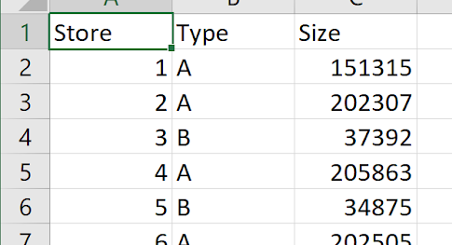
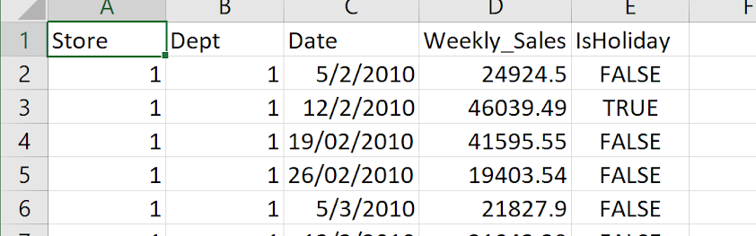
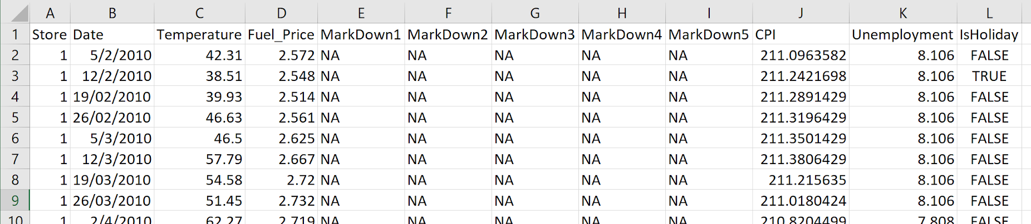
Background
Weekly sales figures for 45 brick and mortar stores
Data for January 2010 thru December 2013
Features Data Set - 8191 rows, 12 columns
Sales Data Set - 421,571 rows, 5 columns
Stores Data Set - 45 rows, 3 columns

Slide 4
Project Variables
Prediction Variable - Weekly Sales for next Quarter
Raw Data Variables
Sales Amount
Date
Store Size
Temperature
Unemployment Rate
Holiday
Fuel Price
Variable Description
Provided in $’s
MM/DD/YYYY
Square Footage
Deg. Fahrenheit
Provided as #.###%
True/False
Provided in $’s
Secret Weapon Variable???

Slide 5
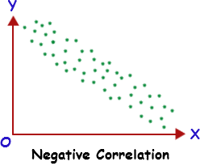
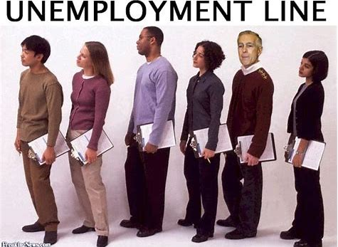
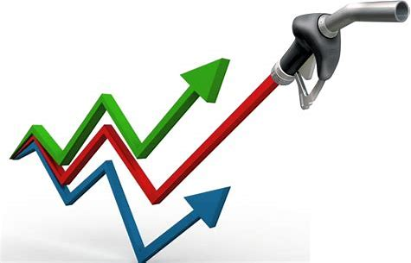
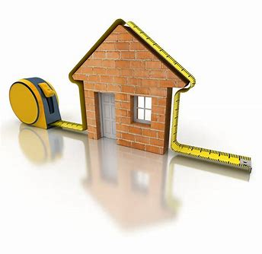
Research Questions
Does Unemployment Rate have a negative correlation with Sales?
When comparing between higher and lower unemployment, is the delta between holiday sales averages statistically significant?
If fuel cost is high, does a high or low temp still drive sales?
Does store size equate to larger sales figures?

Slide 6
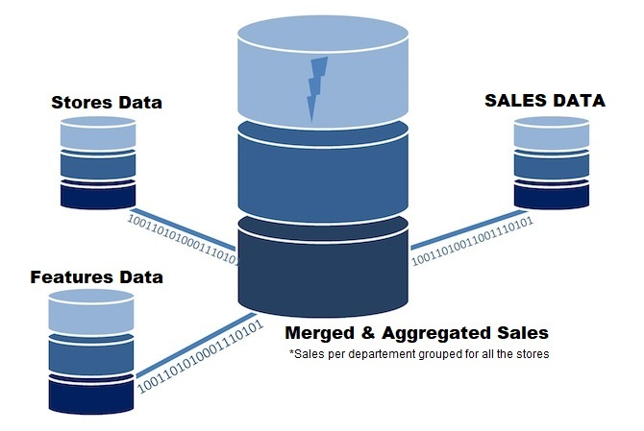
Initial Data Pre-processing

Slide 7
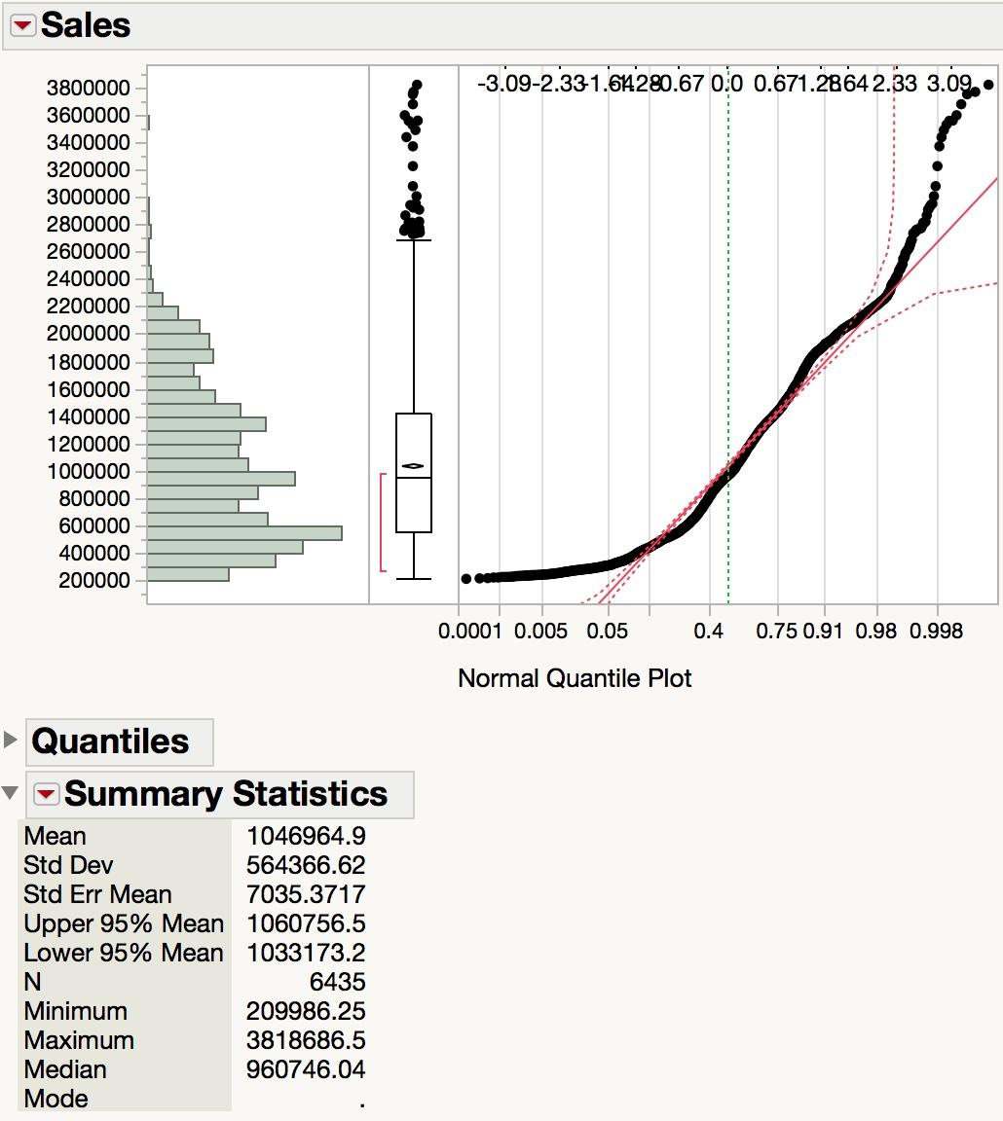
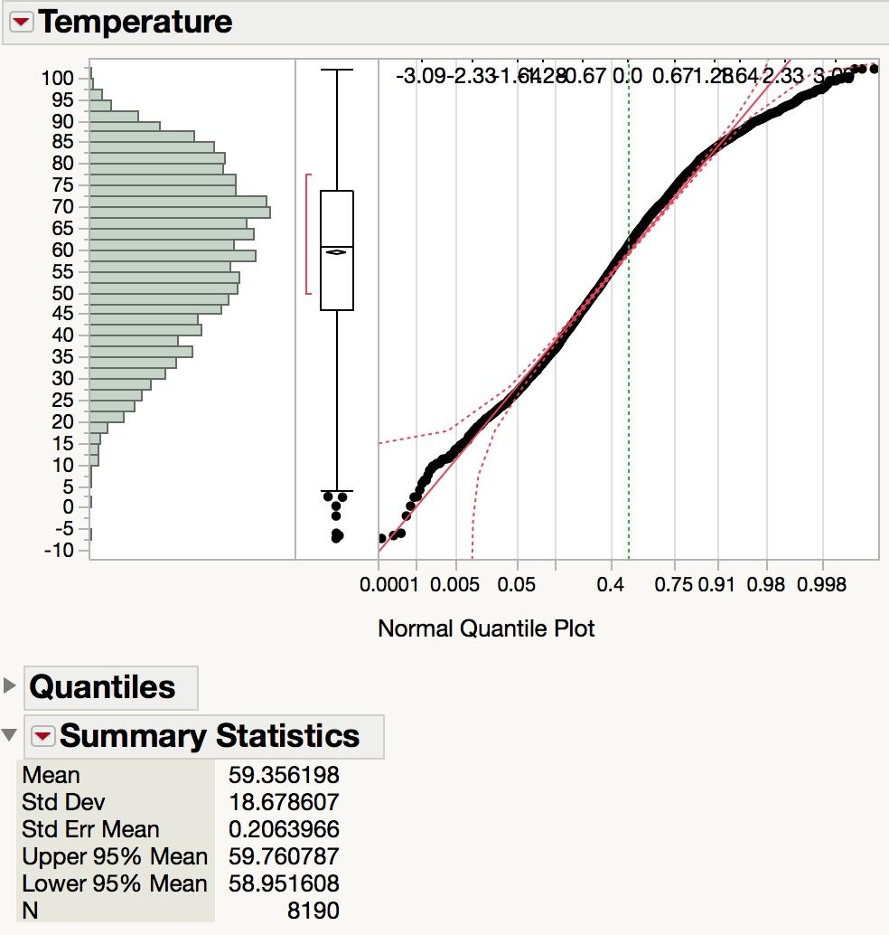
Statistics

Slide 8
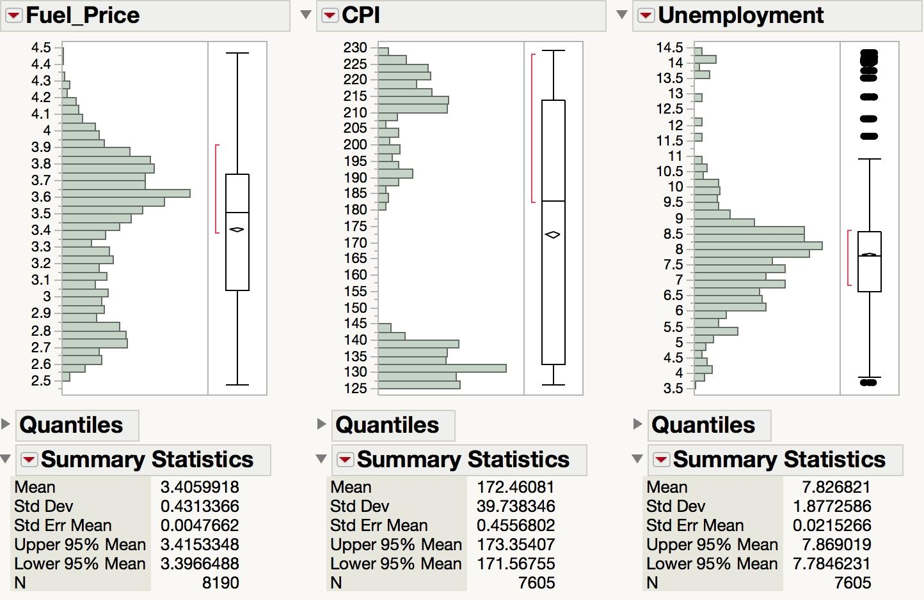
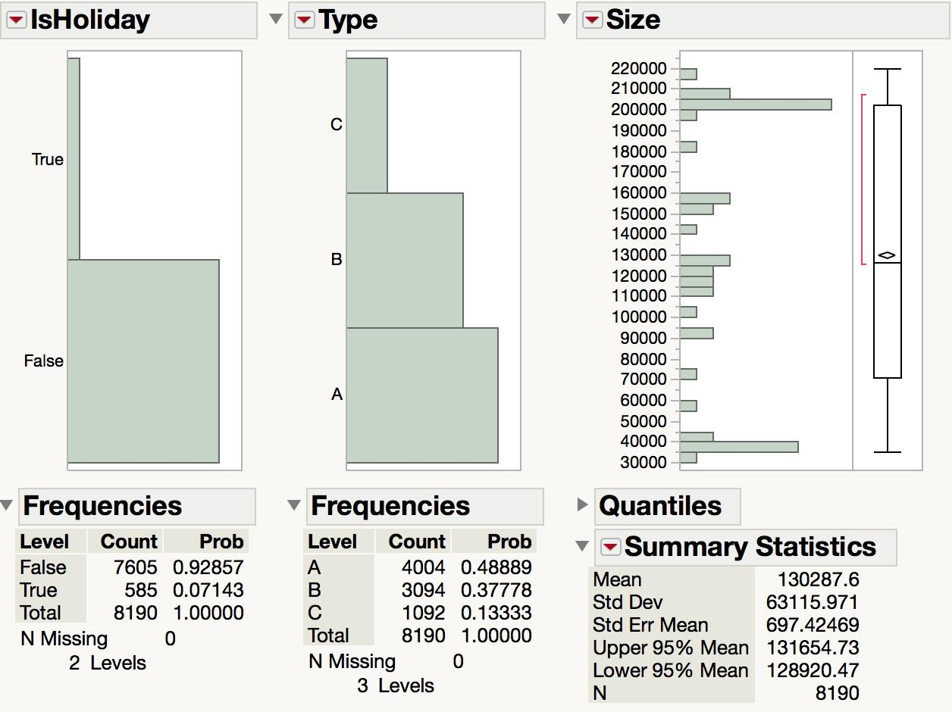
Statistics

Slide 9
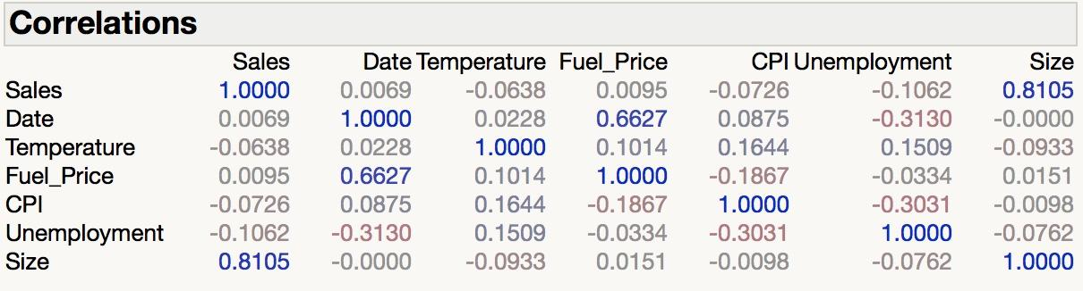
Correlations

Slide 10
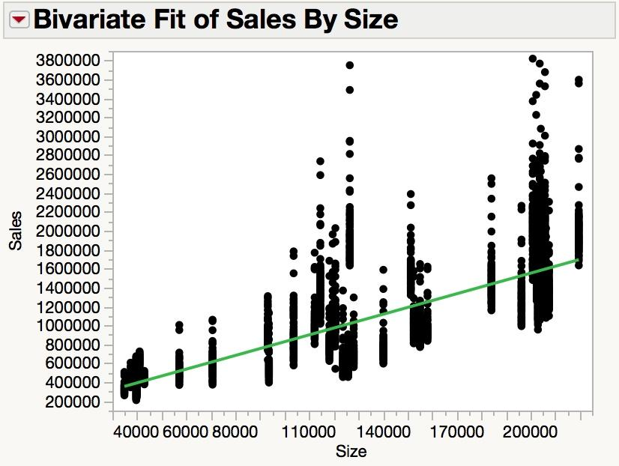
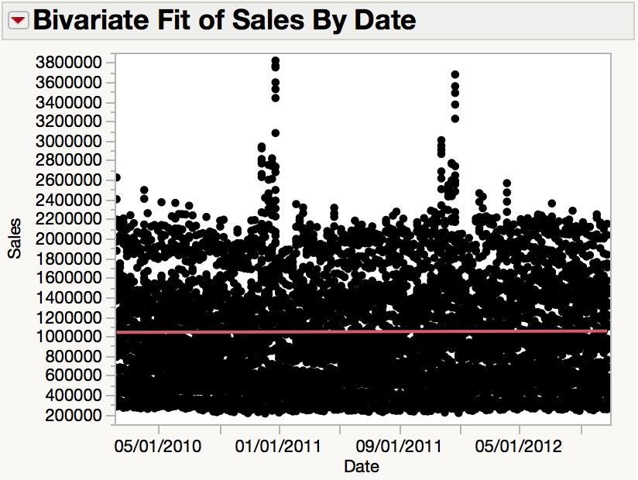
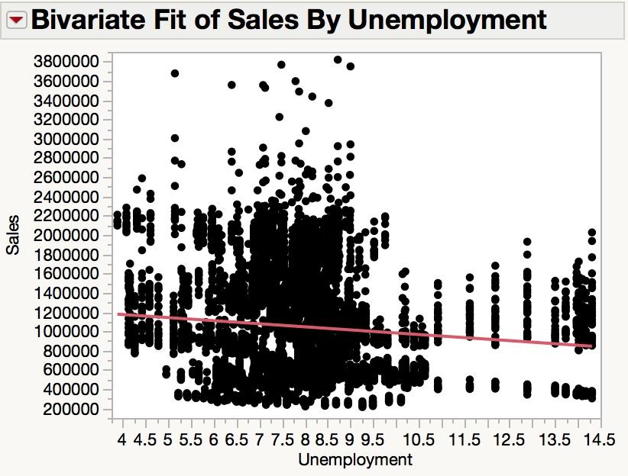
Observations

Slide 11
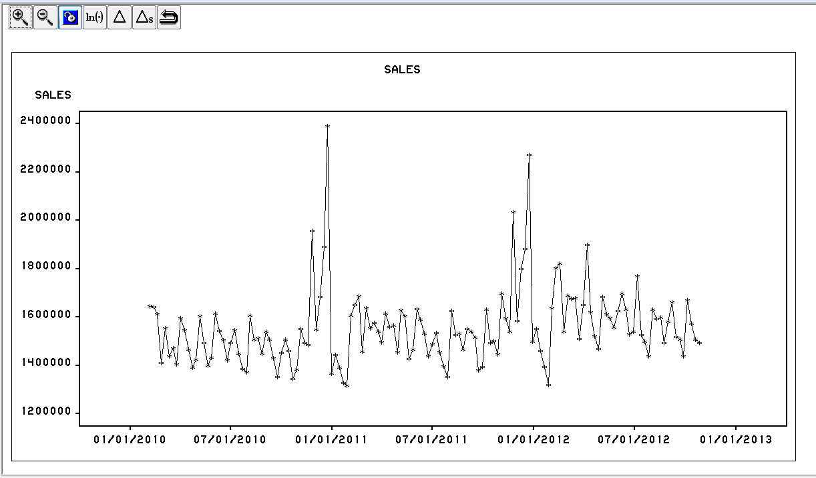
Time Series

Slide 12
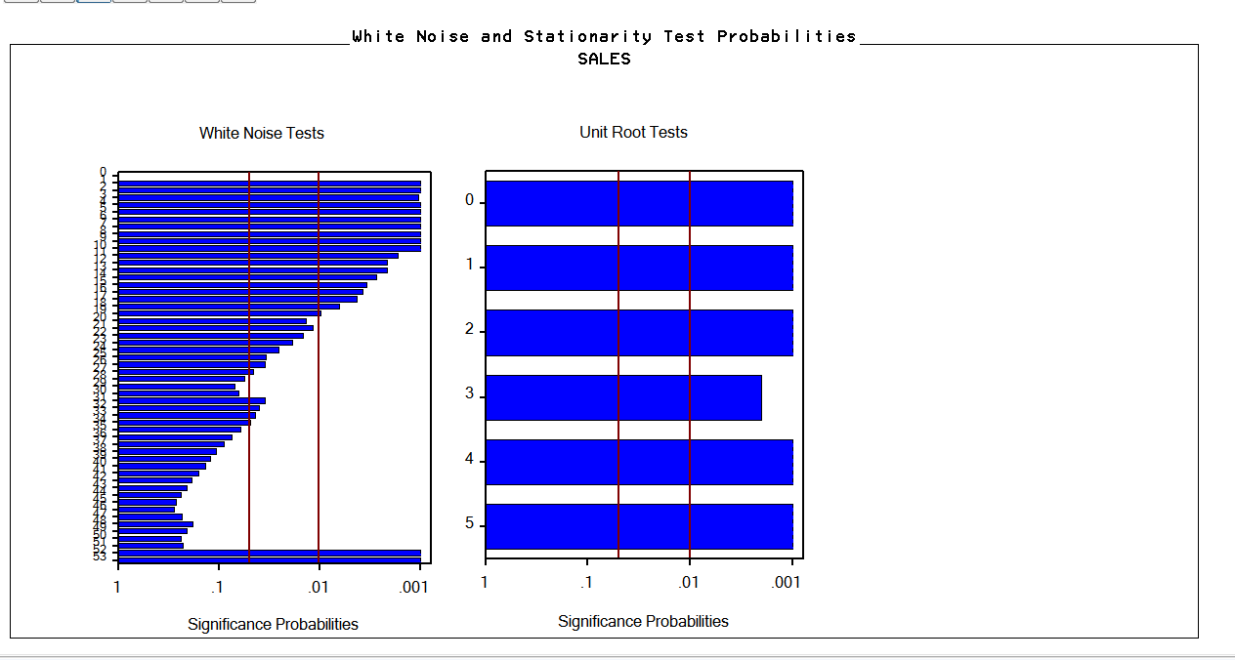
White noise and unit root test

Slide 13
Challenges
Date format not consistent (d/M/yy or d/MM/yyyy or dd/MM/yy); Converted to MM/dd/yyyy
Missing data in markdown columns - Assumed as no discount offered
Data from 45 different stores and various departments within each store
Data provided in 3 different tables - Merged
Sales affected by both
External factors - Temp, holiday, fuel price, CPI
Internal factors - Markdown, size, type

Slide 14
Project Roadmap
Define the objectives (Research questions)
Clean the data
Explore the relationship among the variables
Analyze the data
Develop various models
Evaluate and select the best model
Forecast sales for missing weeks
Answer the research questions
Does Unemployment Rate have a negative correlation with Sales?
When comparing between higher and lower unemployment, is the delta between holiday sales averages statistically significant?
If fuel cost is high, does a high or low temp still drive sales?
Does store size equate to larger sales figures?

Slide 15
Questions?

